Slide 1

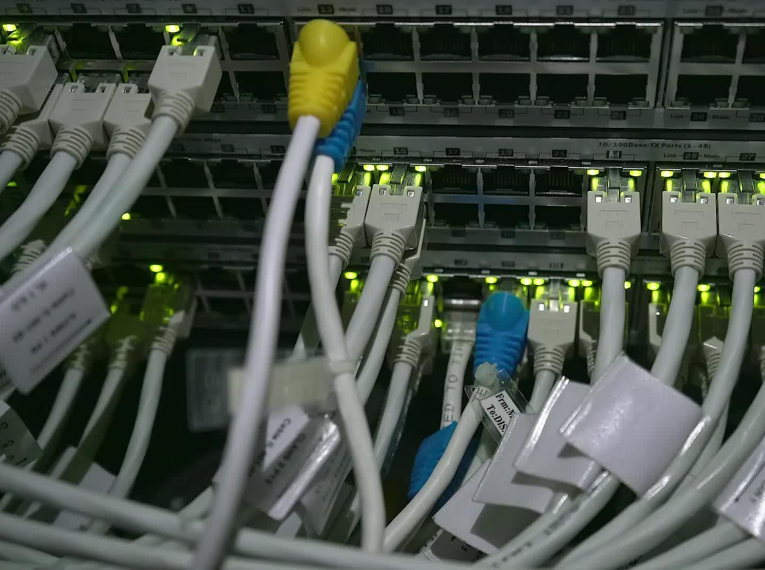


CS621 Parallel and Distributed Computing
Dr. Muhammad Anwaar Saeed
Dr. Said Nabi
Ms. Hina Ishaq

Slide 2
CS621 Parallel and Distributed Computing
Introduction to Distributed Computing

Slide 3

Objectives
Detailed explanation of distributed computing.

Slide 4
Introduction to Distributed Computing
“A distributed system is a collection of independent computers that appears to its users as a single coherent system.”

Slide 5


Introduction to Distributed Computing Cont.…
In distributed computing
  We have multiple autonomous computers which seems to the user as single system.
  There is no shared memory and computers communicate with each other through message passing.
  A single task is divided among different computers.
Uses or coordinates physically separate computing resources:
  Grid computing
  Cloud Computing

Slide 6
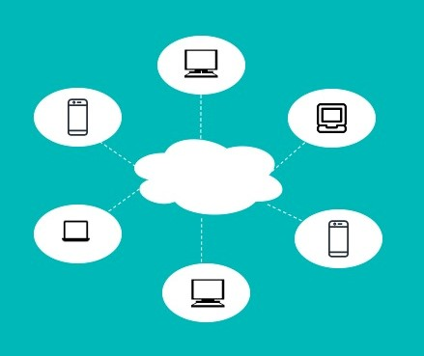
Introduction to Distributed Computing Cont.…

Slide 7
CS621 Parallel and Distributed Computing
Why Use Distributed Computing?

Slide 8
Objectives
Identifying the aspects that makes distributed computing more useful.

Slide 9
Why Use Distributed Computing
Heterogeneity
Resources accessibility
Distribution Transparency
Scalability
Openness
Fault tolerance, error recovery
Concurrency
Resiliency

Slide 10
Why use Distributed Computing
Heterogeneity
The Internet enables users to access services and run applications over a heterogeneous collection of computers and networks.
Distribution Transparency
A distributed system that is able to present itself to users and applications as if it were only a single computer system is said to be transparent.
Openness
An open distributed system is a system that offers services according to standard rules that describe the syntax and semantics of those services.
Resiliency
With multiple computers, redundancies are implemented to ensure that a single failure doesn't equate to systems-wide failure.

Slide 11
Why use Distributed Computing Cont.…
Scalability
Scalability of a distributed system can be measured along at least three different dimensions: a system can be scalable with respect to its size, a geographically scalable system, a system can be administratively scalable.
Resources accessibility
The main goal of a distributed system is to make it easy for the users to access remote resources, and to share them in a controlled and efficient way.
Concurrency
Concurrency between programs sharing data is generally kept under control through synchronization mechanisms for mutual exclusion and transaction.
Fault tolerance, Error recovery
Fault tolerance is an important aspect in distributed systems design. A system is fault tolerant if it can continue to operate in the presence of failures.

Slide 12
CS621 Parallel and Distributed Computing
Difference between Parallel and Distributed Computing

Slide 13

Objectives
Identifying the key differences between parallel and distributed computing.

Slide 14
Difference between Parallel and Distributed Computing
Distributed computing is often used in tandem with parallel computing. Parallel computing on a single computer uses multiple processors to process tasks in parallel, whereas distributed parallel computing uses multiple computing devices to process those tasks.

Slide 15
Difference between Parallel and Distributed Computing Cont…
Sr.
Parallel Computing
Distributed Computing
1.
Many operations are performed
System components are located at different
simultaneously
locations
2.
Single computer is required
Uses multiple computers
3.
Multiple processors perform multiple
Multiple computers perform multiple operations
operations
4.
Processors communicate with each
Computer communicate with each other through
other through bus
message passing.
5.
Improves the system performance
Improves system scalability, fault tolerance and
resource sharing capabilities

Slide 16
CS621 Parallel and Distributed Computing
Applications of Parallel and Distributed Computing

Slide 17
Objectives
Scope of parallel and distributed computing.

Slide 18
Applications of Parallel and Distributed Computing
Science
Google
Engineering
P2P Network
Business
Defense

Slide 19
Applications of Parallel and Distributed Computing
Science
  Global climate modeling
  Biology: genomics; protein folding; drug design
  Astrophysical modeling
  Computational Chemistry
  Computational Material Sciences and Nano sciences
Engineering
  Semiconductor design
  Earthquake and structural modeling
  Computation fluid dynamics (airplane design)
  Combustion (engine design)
  Crash simulation

Slide 20
Applications of Parallel and Distributed Computing Cont.…
Business
  Financial and economic modeling
  Transaction processing, web services and search engines
Defense
  Nuclear weapons -- test by simulations
  Cryptography

Slide 21
Applications of Parallel and Distributed Computing Cont.…
P2P Network
  eDonkey, BitTorrent, Skype, …
Google
  1500+ Linux machines behind Google search engine

Slide 22
CS621 Parallel and Distributed Computing
Issues in Parallel and Distributed Computing

Slide 23
Objectives
Identifying the key challenges in parallel and distributed computing.

Slide 24
Issues in Parallel and Distributed Computing
Failure Handling
Communication
Scalability
Resource management
Security
Process synchronization

Slide 25
Issues in Parallel and Distributed Computing
Failure Handling
Failures, like in any program, are a major problem. With so many processes and users, the consequences of failures are exacerbated.
Scalability
As a distributed system is scaled, several factors need to be taken into account: size, geography, and administration; and their associated problems like overloading, control and reliability.
Security
As connectivity and sharing increase, security is becoming increasingly important. Increased connectivity can also lead to unwanted communication, such as electronic junk mail, often called spam.

Slide 26
Issues in Parallel and Distributed Computing Cont.…
Process synchronization
One of the most important issues that engineers of distributed systems are facing is synchronizing computations consisting of thousands of components. Current methods of synchronization like semaphores, monitors, barriers, remote procedure call, object method invocation, and message passing, do not scale well.
Resource management
In distributed systems, objects consisting of resources are located on different places. Routing is an issue at the network layer of the distributed system and at the application layer. Resource management in a distributed system will interact with its heterogeneous nature.
Communication and Latency
Distributed Systems have become more effective with the advent of Internet but there are certain requirements for performance, reliability etc. Effective approaches to communication should be used.

Slide 27
CS621 Parallel and Distributed Computing
Parallel and Distributed Computing Efforts

Slide 28
Objectives
Identifying the prerequisites for parallel and distributed computing.

Slide 29
Parallel and Distributed Computing Programming Design Efforts
Before a program is written or a piece of software is developed, it must first go through a design process.
For parallel and distributed programs, the design process will include three issues:
  Decomposition
  Communication
  Synchronization

Slide 30
Decomposition
Decomposition is the process of dividing up the problem and the solution into parts: logical areas and logical resources.
One of the primary issues of concurrent programming is identifying a natural WBS(Work breakdown structure) for the software solution at hand.

Slide 31
Communication
Following issues must be considered when designing parallel or distributed systems:
Important Questions:
  How will this communication be performed if the parts are in different processes or different computers?
  Do the different parts need to share any memory?
  How will one part of the software know when the other part is done?
  Which part starts first?
  How will one component know if another component has failed?

Slide 32
Synchronization
The components' order of execution must be coordinated. . Do all the parts start at the same time or does some work while others wait?
What two or more components need access to the same resource?
Who gets it first? If some of the parts finish their work long before the other parts, should they be assigned new work?
Who assigns the new work in such cases?
The WBS designates who does what.
When multiple components of software are working on the same problem, they must be coordinated.

